Slide 1
Zostera capensis genome assembly

Slide 2
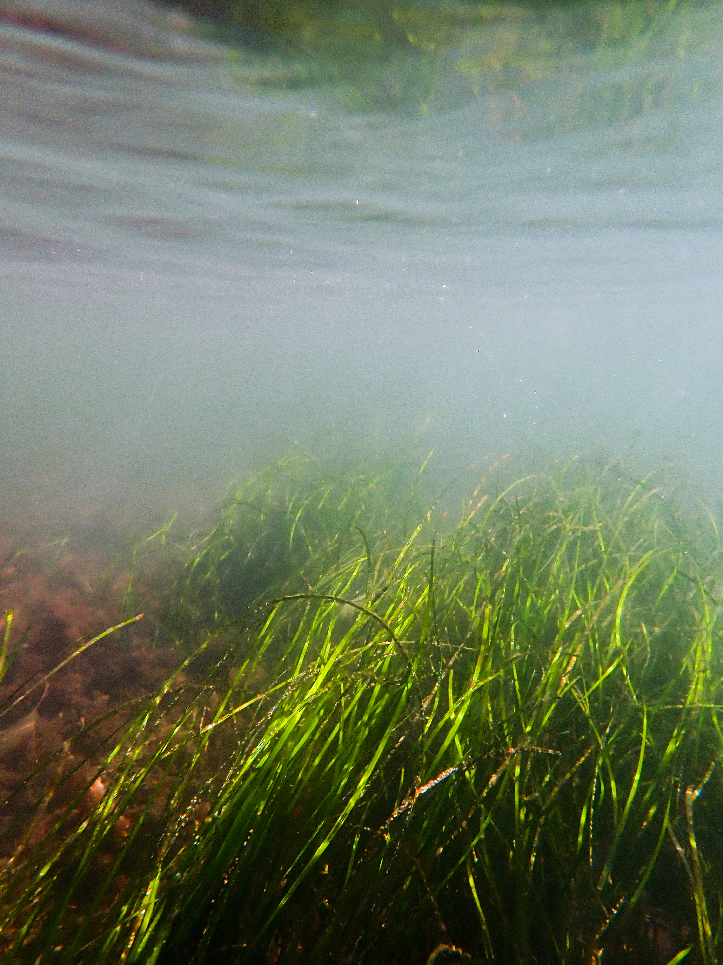
agenda
Status of Zostera sp. Genome work
Is it haploid or diploid?
How many chromosomes?

Slide 3
zostera genome assemblies:
Zostera capensis
The 1st seagrass genome in Africa?
Jan 2016
Zostera marina (v1.0)
July 2016
Zostera muelleri
2024 ?
April 2021
Update for Z. marina (V3.1)
March 2023
Second update for Z. marina (v4.0?)
Notes:
Zostera angustifolia (Hornem.) Rchb. – Russian Far East, British Isles, Denmark, Sweden
Zostera asiatica Miki – Russian Far East, Japan, Korea, NE China
Zostera capensis Setchell – Madagascar; Kenya to Cape Province
Zostera caulescens Miki – Russian Far East, Japan, Korea, NE China
Zostera chilensis (J. Kuo) S. W. L. Jacobs & D. H. Les – Chile
Zostera japonica Ascherson & Graebner – Russian Far East, Japan, Korea, China, Vietnam
*Zostera marina L. – shores of North Pacific, North Atlantic, British Isles Mediterranean, Black Sea, Sea of Okhotsk
*Zostera muelleri Irmisch ex Ascherson – Australia
Zostera nigricaulis (J.Kuo) S.W.L.Jacobs & D.H.Les – Australia
Zostera caespitosa Miki – Russian Far East, Japan, Korea, NE China
Zostera noltii Hornem. – shores of Northeastern Atlantic, Mediterranean, Black Sea, Caspian Sea
Zostera polychlamys (J.Kuo) S.W.L.Jacobs & D.H.Les – Australia
Zostera tasmanica Martens ex Ascherson – Australia

Slide 4

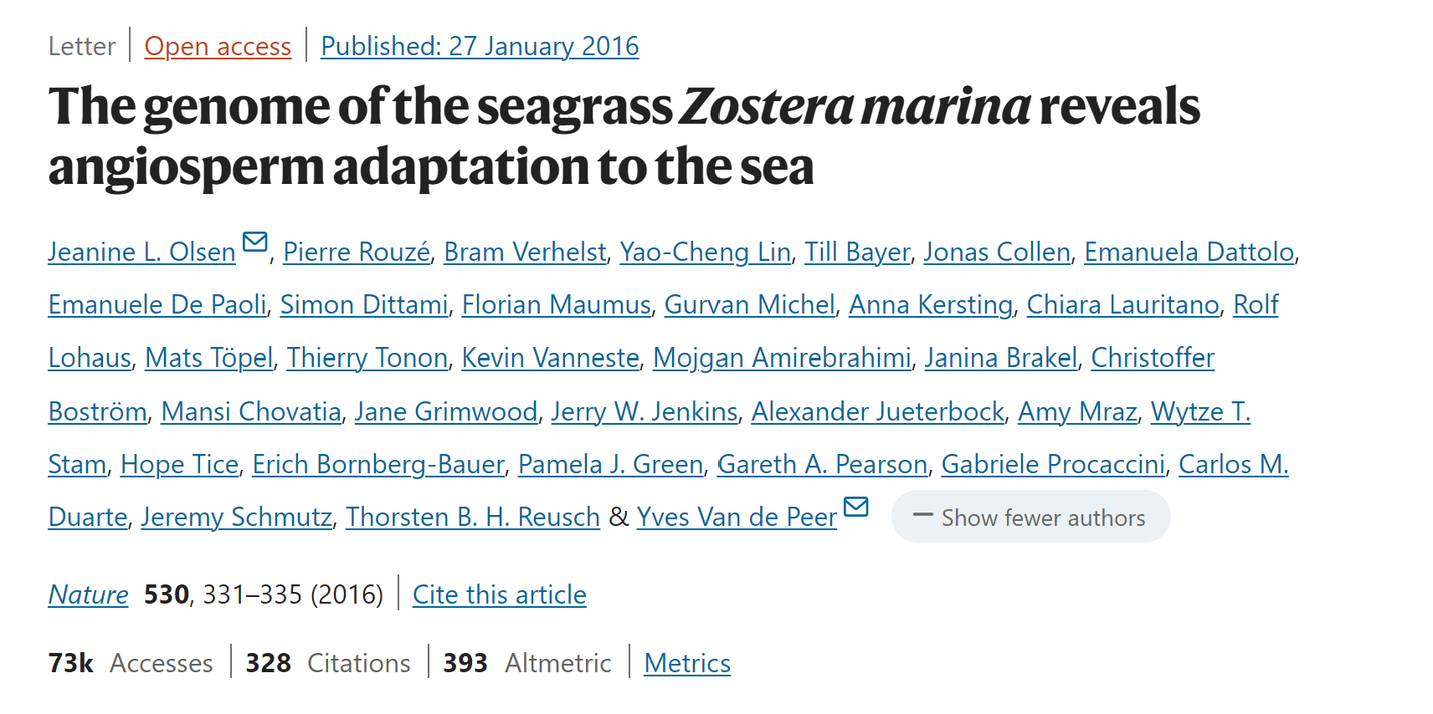
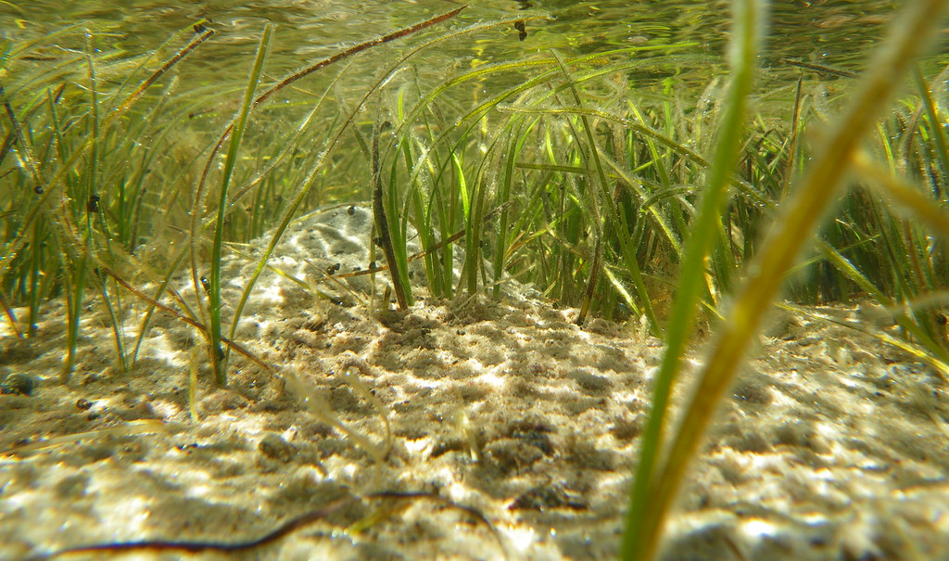
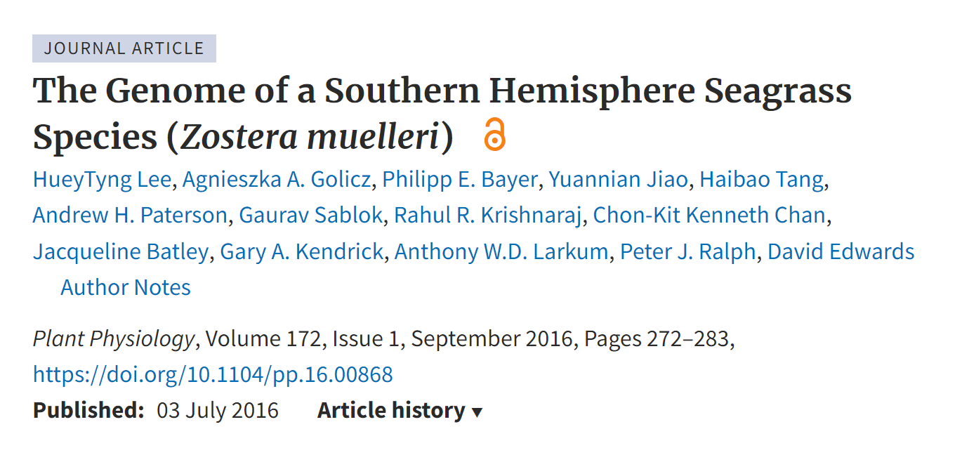
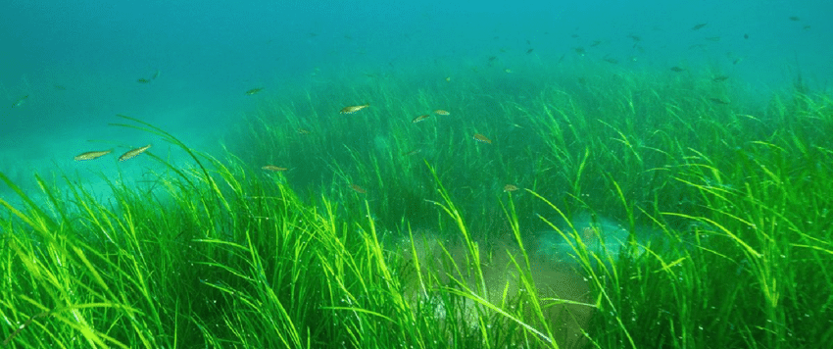
Zostera marina & z. muelleri
Z. mucronata
(Nano)Z. capricorni
Z. novazelandica
Notes:
Zostera marina - https://www.nature.com/articles/nature16548#Sec2
Most wide ranging sp in northern hemisphere. Northern America and Europe – subtropical and subpolar regions
Zostera muelleri (synonyms) - https://academic.oup.com/plphys/article/172/1/272/6115601#236429166
Southern hemisphere. Australia, NZ, Papua New Guinea
Both = Flowering and produces seeds & veg reproduction to form a genet (clonal colony)

Slide 5
Zostera marina Olsen et al., 2016 (V1.0)
237.5 Mb
20,450 protein-coding genes
90% of eukaryotic core genes were present
Key adaptations:
- stomatal genes, compound biosynthesis & signalling, uV protection
+ salinity, ion homeostasis
Notes:
The Zostera marina genome sequence is 202.3 Mb and encodes approximately 20450 protein-coding genes (of which 86,6% are supported by transcriptome data)
The assembled genome was found to consist of large numbers of repeat elements accounting for 63% of the assembled genome
Revealed key adaptations at the molecular biological level that have occurred during evolution of Z. marina, including losing the entire repertoire of stomatal genes, genes involved in volatile compound biosynthesis and signalling (such as ethylene and terpenoids) as well as genes for ultraviolet protection and phytochromes used for far-red sensing. Besides these gene losses, also gene gain events have been described, mostly involving the adjustment to full salinity and ion homeostasis

Slide 6
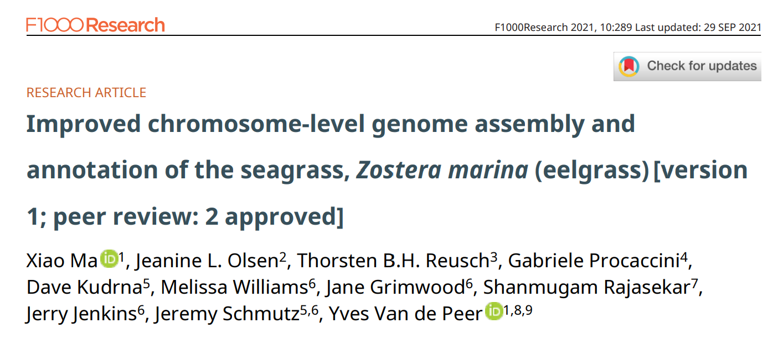
New & improved (v3.1) ma et al., 2023
260.5 Mb (+ 23 MB from v1.0)
21,483 protein-coding genes
BUSCO = 95.7%
Haploid
Chromosome number = 6
Notes:
https://www.ncbi.nlm.nih.gov/pmc/articles/PMC8482049/

Slide 7
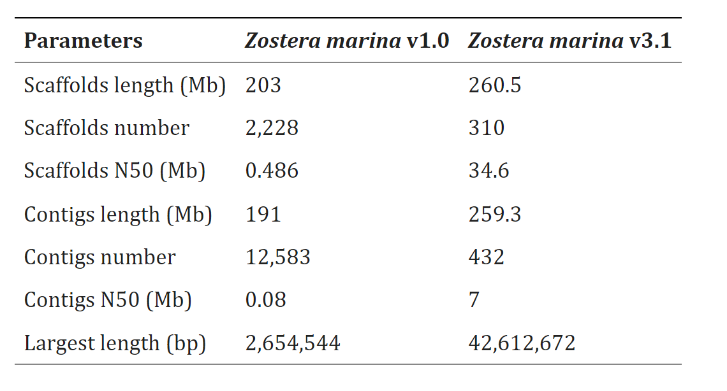

Slide 8
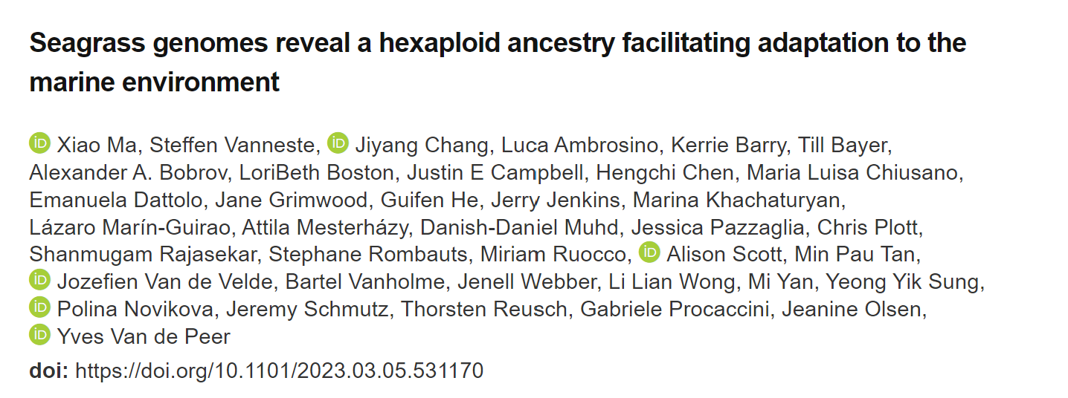
Updated, v4.0? Ma et al., 2023
Improved assembly…of the chloroplast genome
Notes:
https://www.biorxiv.org/content/10.1101/2023.03.05.531170v1

Slide 9
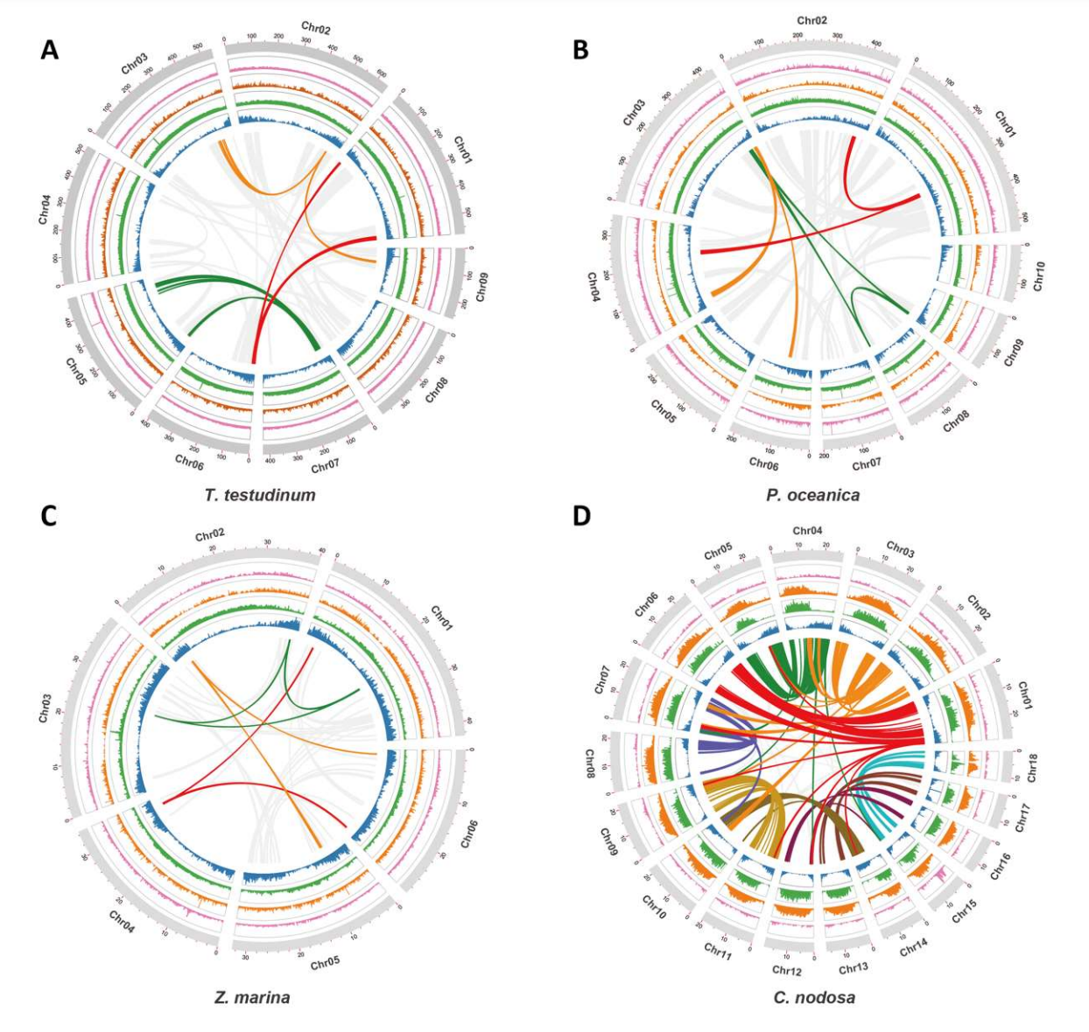
Notes:
Distribution of the genomic features for T. testudinum, P. oceanica, Z. marina and C. nodosa.
Tracks from the inner to outer side correspond to gene density (blue)
LTR/Gypsy density (green)
LTR/Copia (orange)
DNA transposable elements (pink) and chromosomes (with length in Mb)
Curved lines through the centre denote synteny between different genomic regions. Grey lines in A, B and C reflect synteny involving the WGD, whereas the three coloured lines represent synteny with WGTs.

Slide 10
Zostera muelleri Lee et al., 2015
632 Mb (frequency plot est. 889 mb)
35,875 protein-coding genes
BUSCO = 81%
Micrographs showed chromosome no of
2n = 24 (Kuo, 2001)
Notes:
To adapt to life in the ocean, the Z. muelleri genome lost/modified several genes, such as genes for hormone biosynthesis and signalling and cell wall catabolism. Lost genes include those associated with ethylene synthesis and signalling pathways, as well as genes involved in pectin catabolism. Genes for stomatal differentiation, terpenoid synthesis, and ultraviolet resistance were lost. The genes responsible for salinity tolerance and stress-resistance remained.

Slide 11
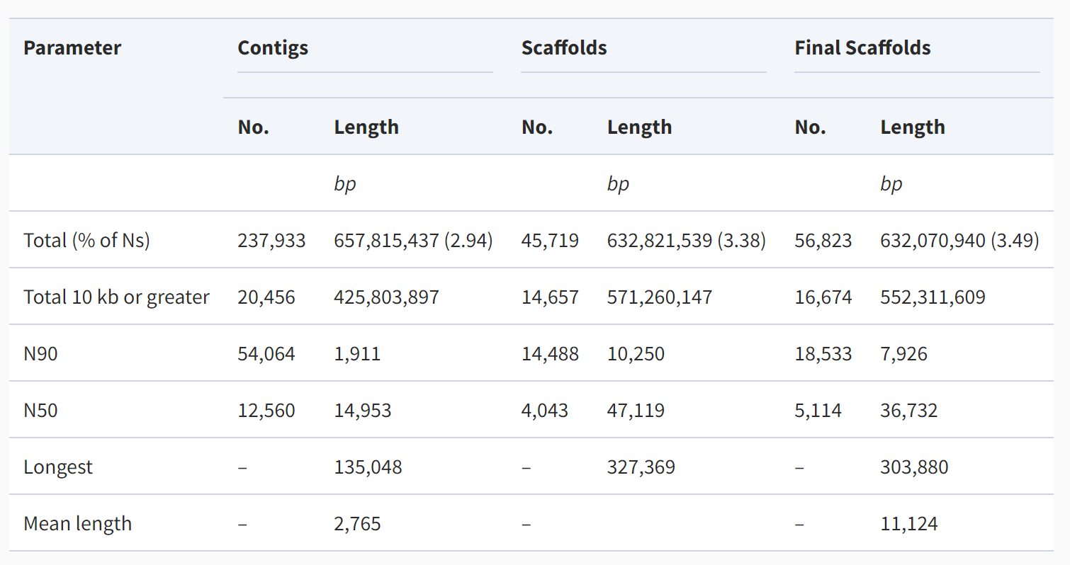

Slide 12
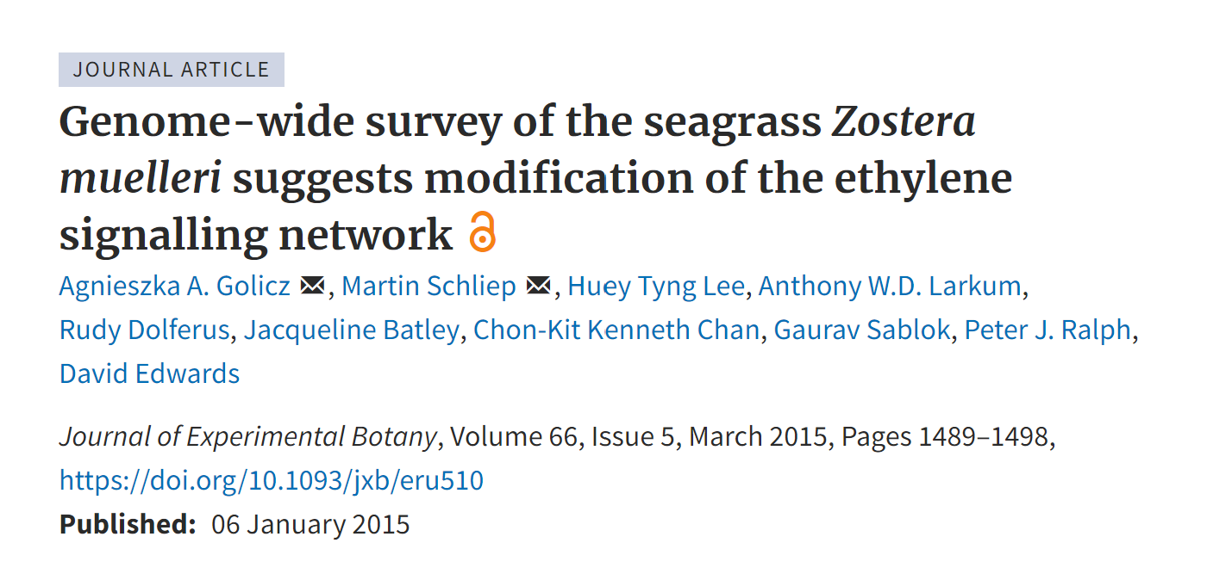
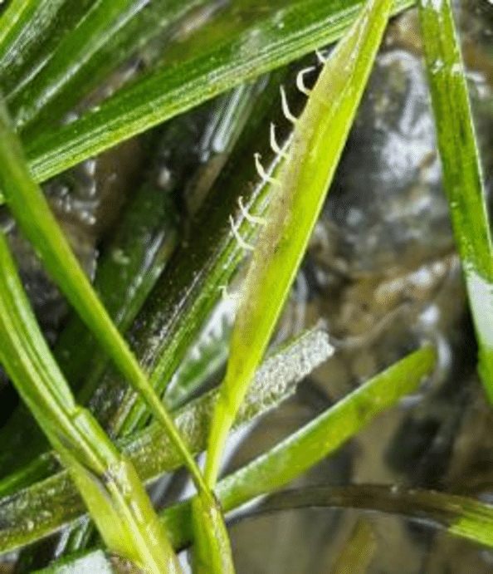
Used unassembled whole-genome shotgun sequence data from:
Notes:
https://academic.oup.com/jxb/article/66/5/1489/584225#84847223

Slide 13
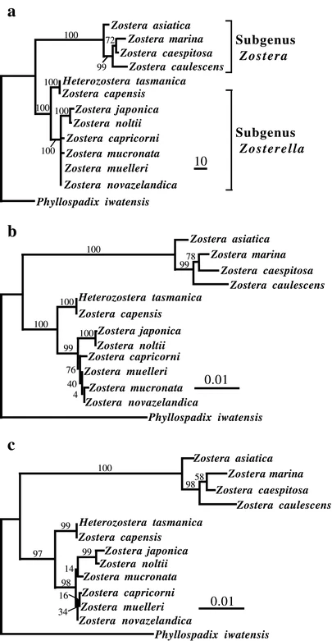
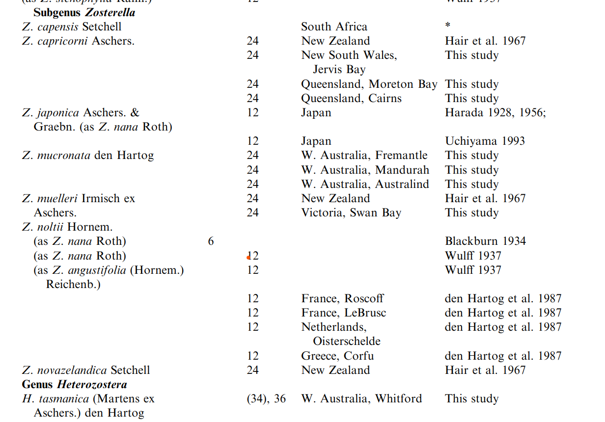
Zostera capensis ?
Kuo, 2001
Tanaka et al., 2003
Notes:
Zosterella:
2n = 12 for northern hemisphere zosteralla sp = Z. noltii & Z. japonica
& diploid
Southern hemisphere = tetraploid (Larkum & den Hartog 1989)
All S. hemisphere sp. So far are 2n = 24
H. Tasmanica – 2n = 36, occasionally 2n = 34
Kuo, 2001 - https://link.springer.com/article/10.1007/s006060170063
Tanaka et al., 2003 - https://link.springer.com/article/10.1007/s10265-003-0090-x

